Slide 1
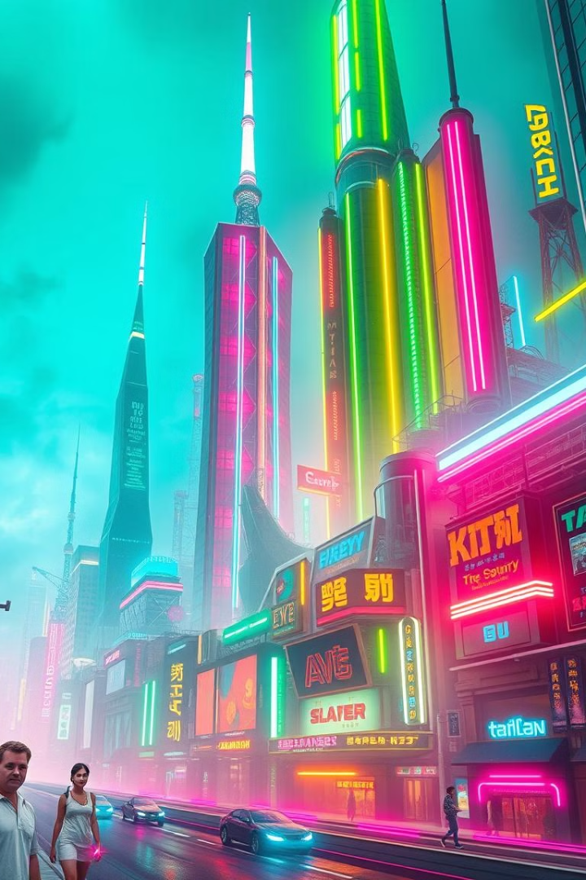

Artificial Intelligence in Entertainment
The entertainment industry is embracing AI, transforming the way we create, consume, and experience media. From music composition to personalized gaming, AI is ushering in a new era of innovation and engagement.
by ShaTech jsjk

Slide 2
AI in Music: Composition, Recommendation, and Mastering
AI Composition
AI Recommendation
AI Mastering
AI algorithms can now compose original music in various genres, mimicking human creativity and generating new soundscapes.
AI-powered music streaming platforms analyze listening habits and offer personalized recommendations, expanding musical horizons.
AI tools assist in mastering music, optimizing audio quality, and ensuring a professional and consistent sound.

Slide 3
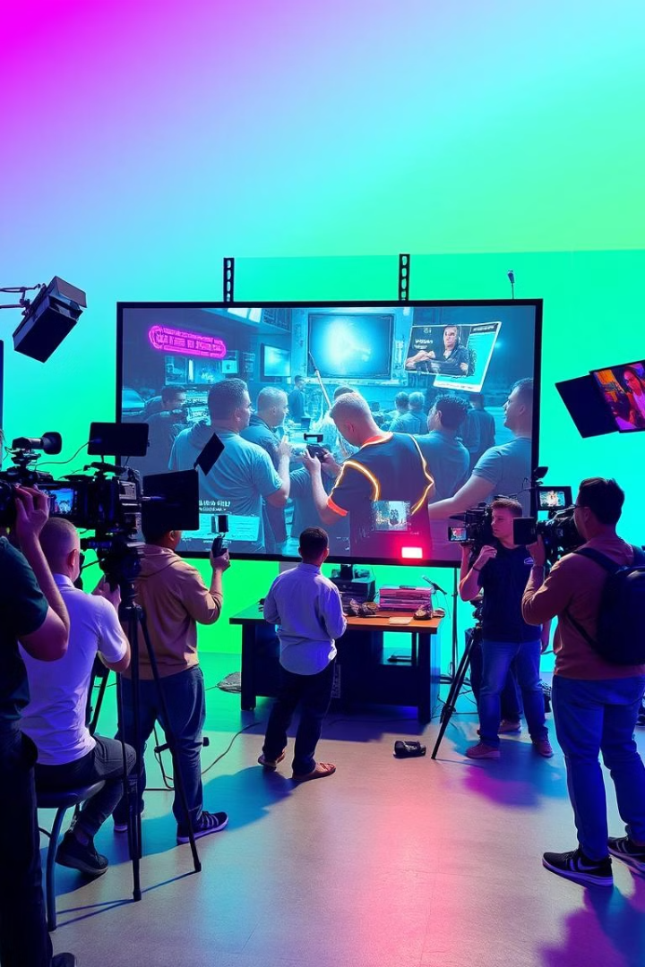
AI in Filmmaking: Script Generation, Editing, and Predictions
AI Script Generation
AI Editing
AI models can generate dialogue, plot points, and characters, offering fresh perspectives for scriptwriters.
AI-powered editing tools accelerate the post-production process, automating tasks like color correction and scene selection.
AI Predictions
AI algorithms analyze audience preferences and predict box office success, guiding film distribution and marketing strategies.

Slide 4
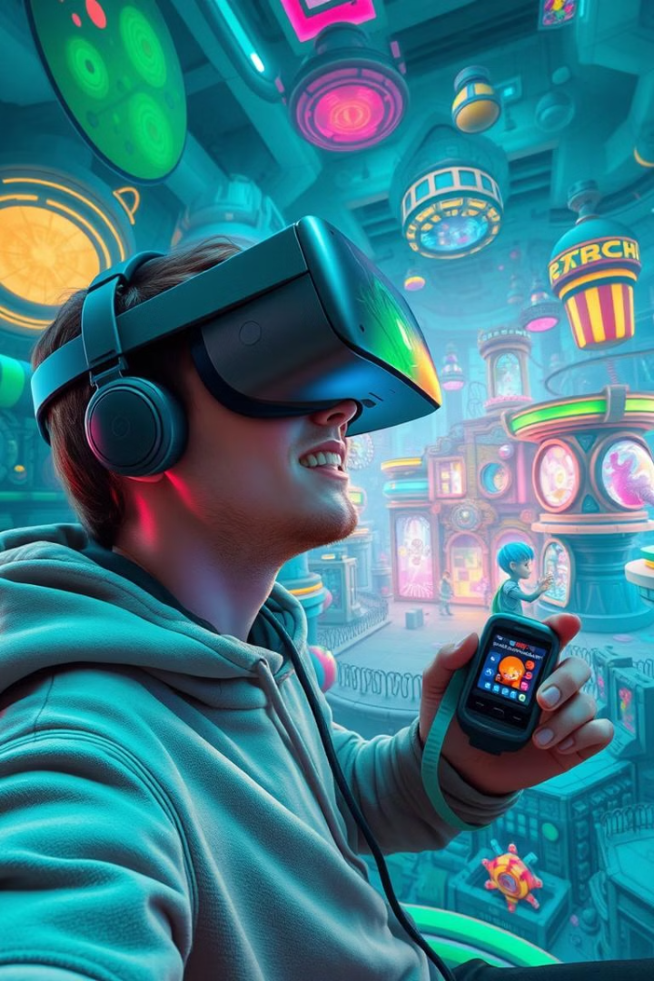


AI in Gaming: Adaptive Gameplay and Personalized Experiences
Adaptive Gameplay
Personalized Experiences
AI-powered games adapt to players' skills and preferences, offering dynamic challenges and personalized difficulty levels.
AI creates unique in-game experiences, tailoring quests, dialogues, and even character appearances to individual players.

Slide 5

AI in Advertising: Audience Targeting and Content Generation
1
AI analyzes user data, including demographics, interests, and online behavior, for precise audience targeting.
2
AI generates personalized ads, tailoring messaging, visuals, and formats to individual preferences and online activity.

Slide 6




AI in Book Publishing: Manuscript Evaluation and Editing
1
Automated Evaluation
2
Grammar and Style Suggestions
3
Market Analysis and Genre Identification
4
Potential Audience Insights

Slide 7
Storytelling with AI: Enhancing Character and Plot Development
1
Character Development
2
Plot Generation
3
Dialogue Creation

Slide 8
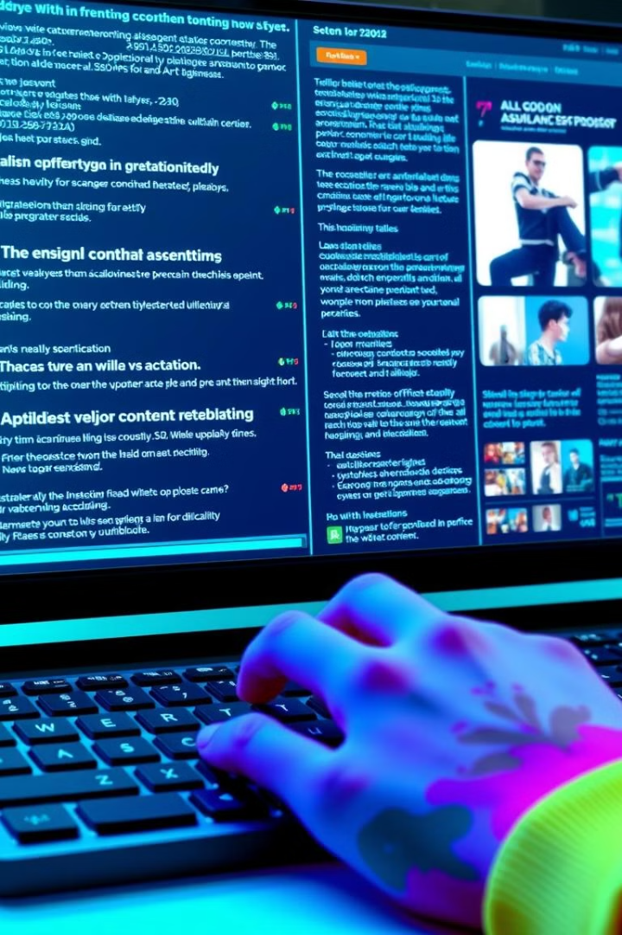
AI Content Creation: Personalization and Automation
1
2
Personalized Recommendations
Automated Content Generation
AI tailors content based on individual preferences and interests, creating a more engaging experience.
AI creates articles, scripts, and even music, streamlining content creation and freeing up creative resources.

Slide 9


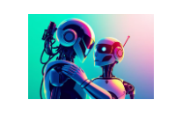
Regulatory Challenges and Content Moderation with AI

Slide 10
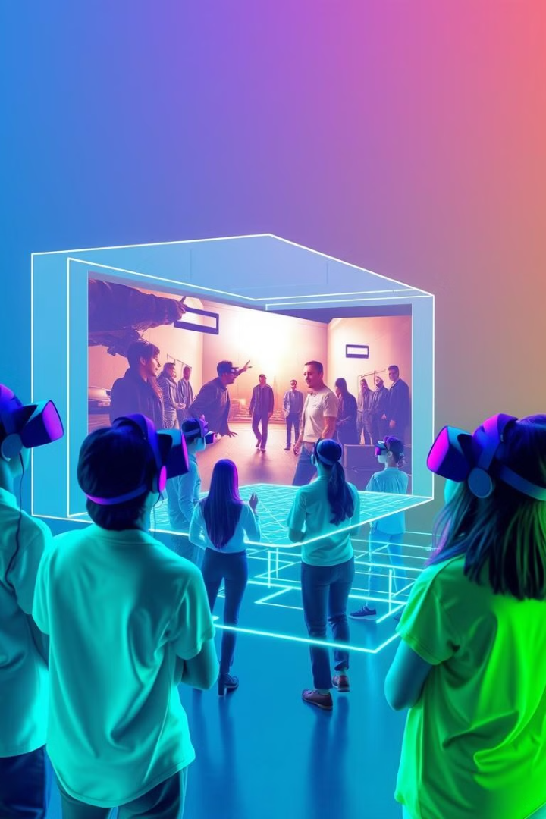
The Future of AI in Media and Entertainment: Trends and Opportunities
AI is poised to revolutionize the entertainment landscape further, creating new forms of media, personalized experiences, and innovative storytelling approaches.

